Slide 1


EDA PROJECT
Name: Aman Verma Registration No. : 12114325 Section: K21UT Roll No. : RK21UTB70 Course: INT 353
This Photo by Unknown Author is licensed under CC BY
Notes:
Are your classroom colors different than what you see in this template? That’s OK! Click on Design -> Variants (the down arrow) -> Pick the color scheme that works for you!
Feel free to change any “You will…” and “I will…” statements to ensure they align with your classroom procedures and rules!

Slide 2
Introduction
Dataset Overview: Exploratory Data Analysis (EDA) is a process of data analysis that involves exploring and understanding data patterns to draw insights. In this project, we will perform EDA on a Spotify songs dataset to understand the music that people listen to.
Objectives of EDA : The objective of this project is to perform exploratory data analysis (EDA) on a Spotify songs dataset to understand the music that people listen to. We will explore the following aspects of the dataset:
The most popular songs, artists, and genres
Trends in listening habits over time
The relationship between people's musical preferences and their demographics, social networks, and other factors
.
Data source: This dataset was collected from Kaggle website Spotify Song Attributes (kaggle.com)

Slide 3
Domain Knowledge
Domain:
The domain of this project is music streaming. Spotify is the world's leading music streaming service, with over 180 million active users. It offers access to over 70 million songs, podcasts, and other audio content. Spotify's vast dataset of user listening data provides a unique opportunity to analyze the music that people listen to and learn more about their musical preferences.
Dataset:
The dataset used in this project is a Spotify songs dataset that contains information about over 1 billion listening events. Each listening event includes the following information:
TrackName
artistName
msPlayed
genre
danceability
energy
key
loudness
liveness
And many such fields.

Slide 4
Libraries used and Approaches
The libraries that I have used in this project are:
NumPy, Pandas, Matplotlib, Seaborn, Scipy
Approach to solve the problem:
First of all import a dataset from Kaggle or Machine Learning Repository .
Then implement summary statistics see how the mean standard deviation is behaving.
After removing those invalid values univariate analysis can be implemented through bar graph and histogram.
After getting insight from univariate, bivariate analysis and multivariate analysis can also be implemented which will give us detail how more than one variables are related to each other.
Then using histplot() visualize which distribution is the dataset following.
At last develop some hypothesis and test whether the dataset is following those hypothesis or not.

Slide 5
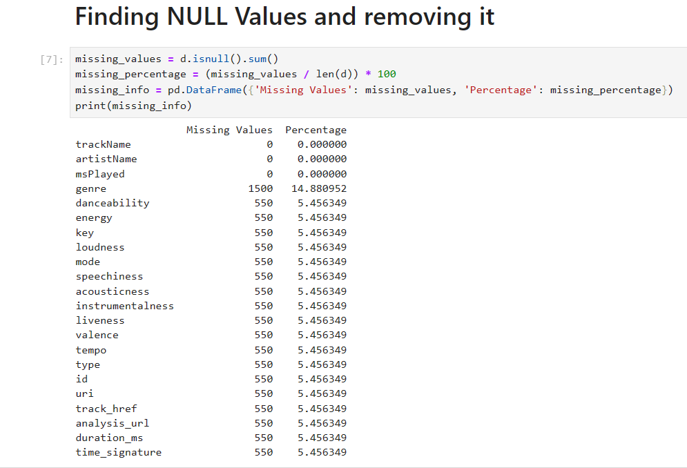
Data Cleaning
Before starting the analysis, first we need to clean and filter the data.
So first it need to checked that how many null values are present in each column.
Use d.is.null().sum() to check total null values in each
column.
Then d.drop_duplicates() was used to drop duplicates if
any duplicate value is present.
After that invalid values were removed from the columns present
In the dataset.
After removing invalid values the size of data points were
reduced to (4290,22) from (10082,22).

Slide 6
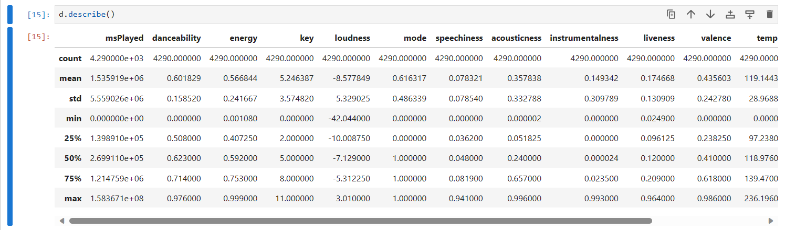
Data Exploration
.
Then summary statistics was perform using d.describe() to find the count, mean, standard deviation, min, max, 25 percentile, 50 percentile and 75 percentile of the dataset.

Slide 7
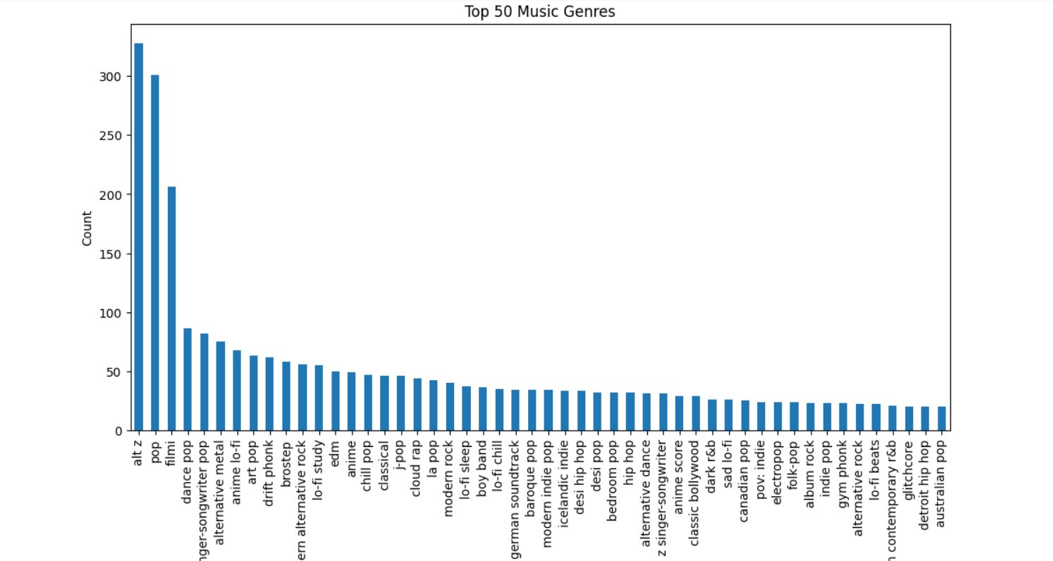
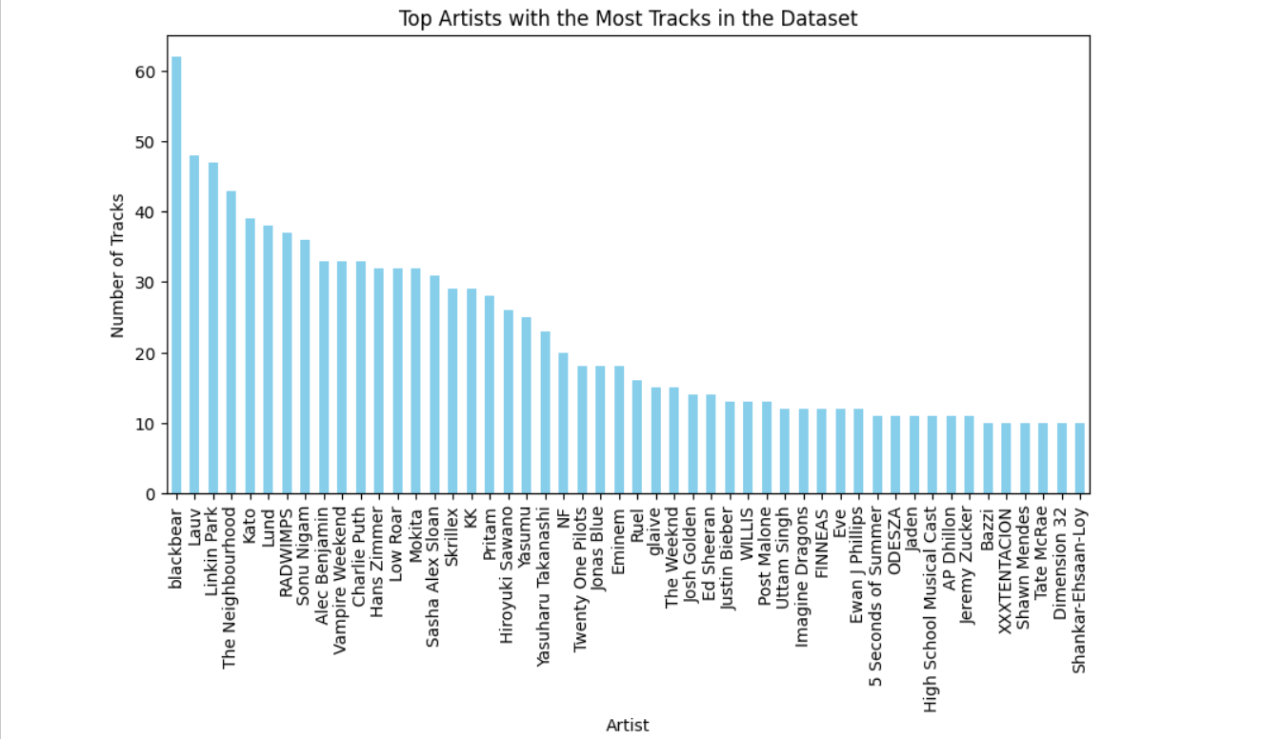
Univariate Analysis
Univariate analysis on various fields such as genres, popularity, danceability, energy level and so on are performed.

Slide 8
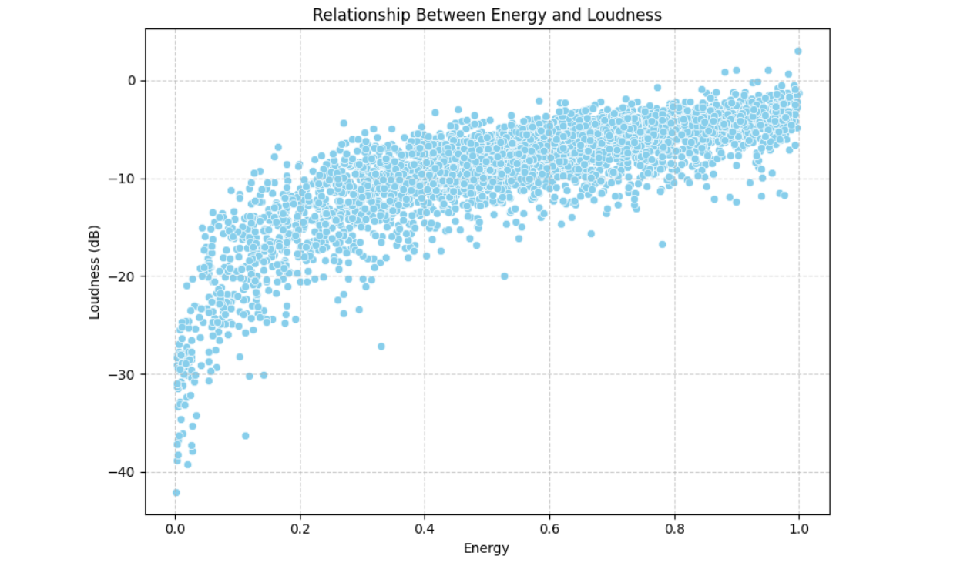
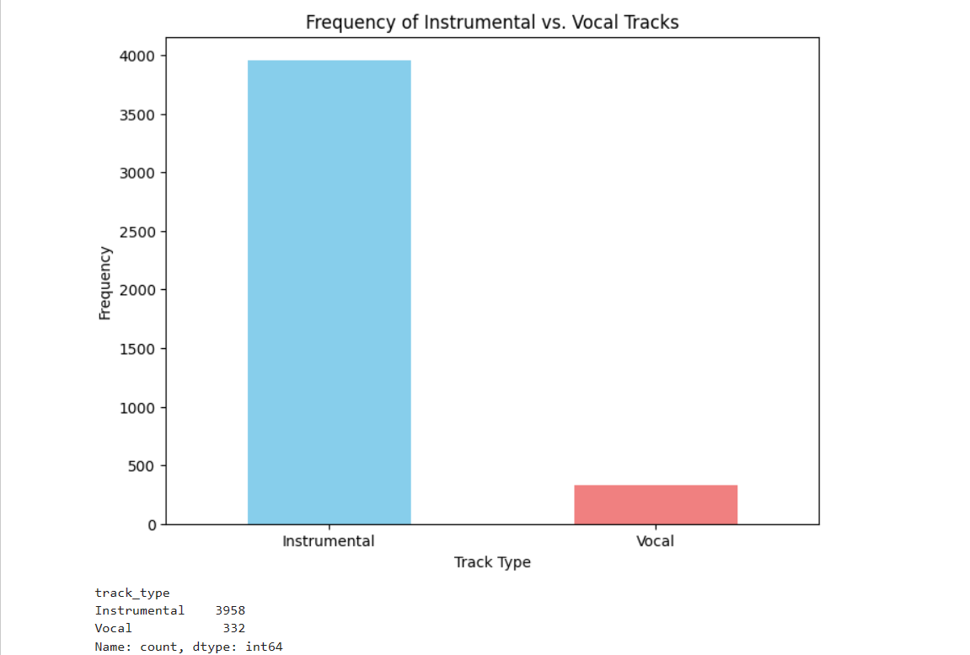
Bivariate Analysis
Bivariate analysis on various fields are performed and scatterplots and countplots are used for analysis.

Slide 9
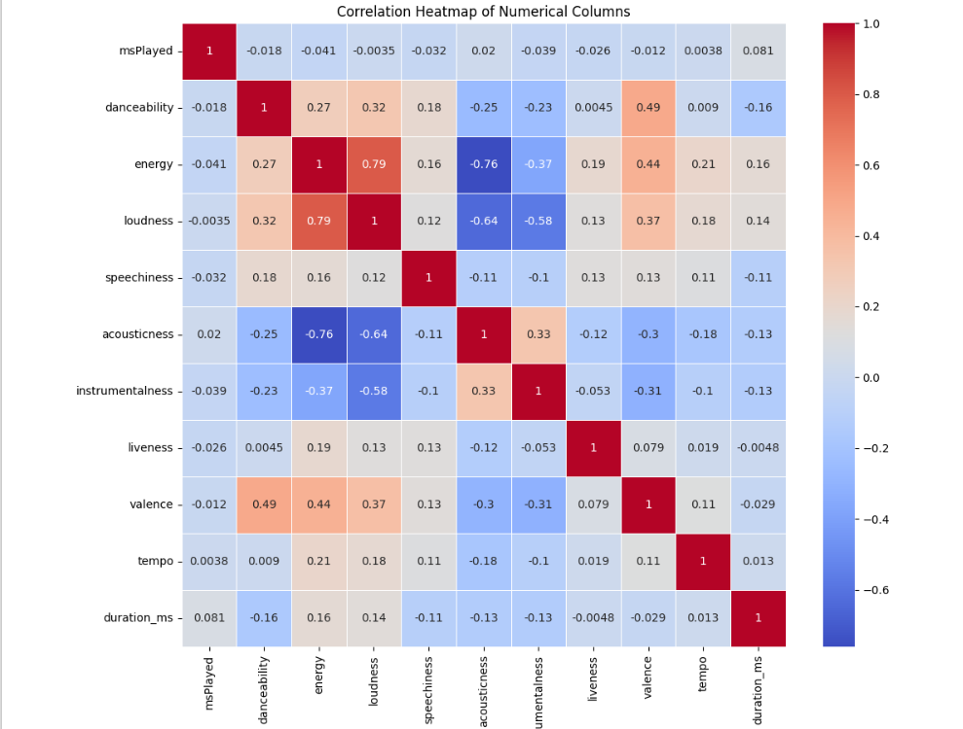
Multivariate Analysis
Multivariate analysis on various fields are performed and heatmaps are used for analysis.

Slide 10
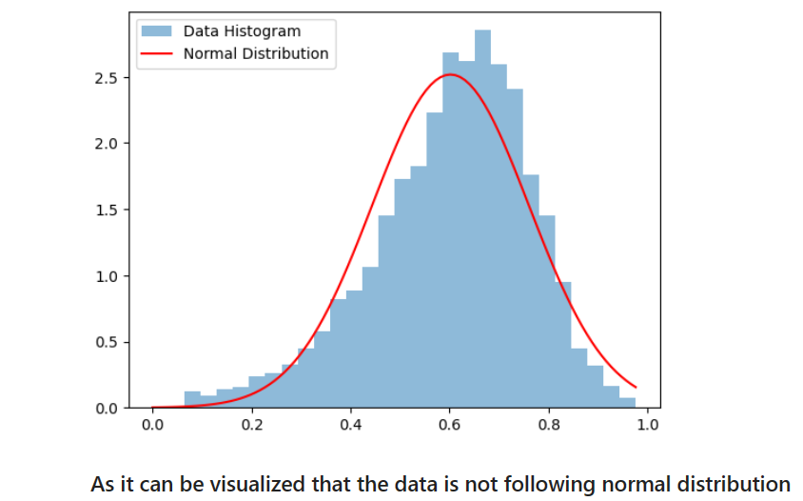
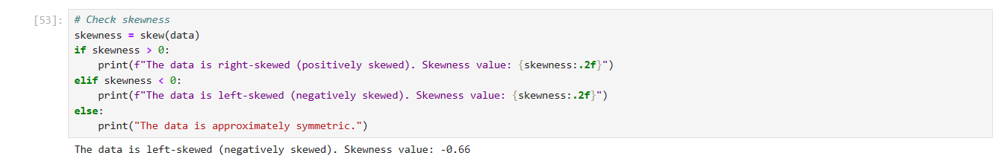
Distributions
Distribution for danceability column was visualized using sns.histplot(d[‘danceability'],kde=True)
A normal distribution plot was plotted on the danceability
using plt.plot (x, stats.norm.pdf(x, np.mean(data), np.std(data)),
'r-', label='Normal Distribution’)
As it can be seen that the data is not following a normal distribution.
Nor is it following any other standard distributions.
Then skewedness was checked for the distribution using
The distribution was found to be left skewed.
Therefore the distribution of danceability column is a left skewed distribution

Slide 11
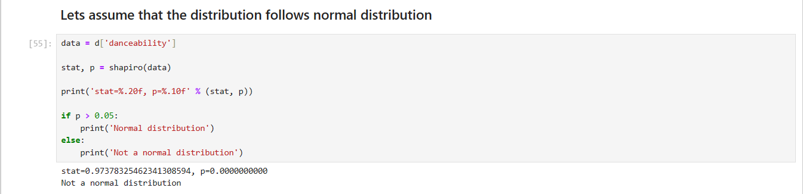
Hypothesis Testing
Following hypothesis were developed and then tested on the data.
1.Normality test using Shapiro-Wilk Test : tests if data is normally distributed.
Normality test was conducted using Shapiro-Wilk method and the distribution was found to be not normal distribution.

Slide 12
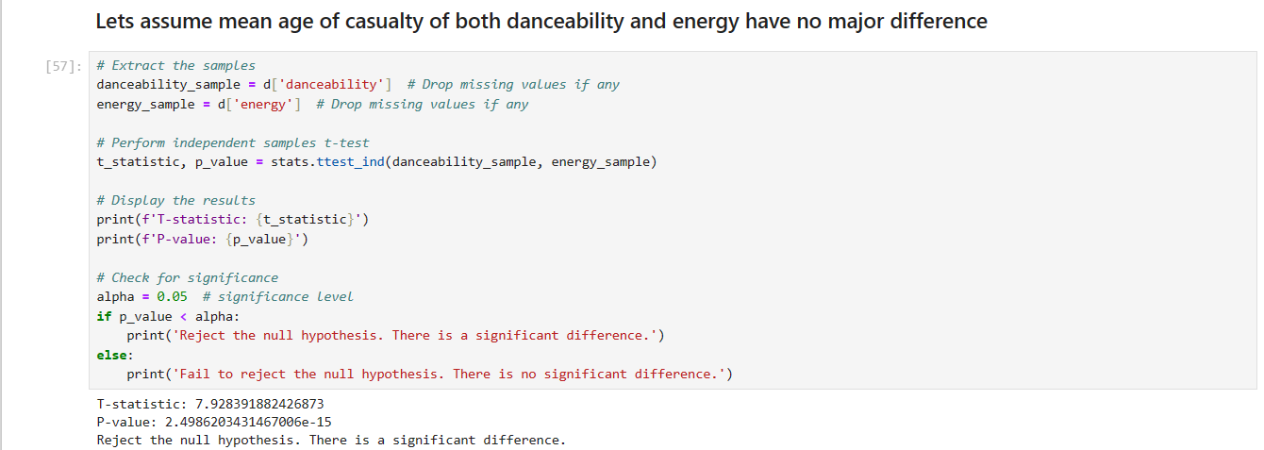
Hypothesis Testing
2.T Test :
the null hypothesis was rejected

Slide 13
Finding and Insight
Genre Diversity:
The dataset encompasses a diverse range of music genres, with varying prevalences.
Some genres exhibit a higher prevalence of live performances, indicating a potential association between musical styles and live recordings.
Instrumental Tracks:
Instrumental tracks are common, pointing to a significant presence of purely instrumental music in the dataset.
Key and Modality:
Major key tracks are more prevalent than minor key tracks, suggesting a general inclination towards a more upbeat tonality.
The prevalence of instrumental tracks indicates a significant presence of purely instrumental music in the dataset.
Correlations:
A correlation between 'energy' and 'loudness' suggests that tracks with higher energy levels tend to be louder, highlighting a natural relationship between these attributes.
Genre-Specific Characteristics:
Exploration of song attributes like 'energy,' 'danceability,' and 'valence' across genres reveals distinct musical characteristics associated with different genres.
Tempo Preferences:
Tempo preferences vary across genres, with some favoring faster tempos while others gravitate towards slower tempos.

Slide 14
7. Acousticness:
Analysis of 'acousticness' across genres reveals that some genres, such as classical and acoustic, predominantly feature acoustic instruments.
8. Speechiness:
The 'speechiness' of tracks varies across genres, indicating differences in the presence of vocals.
9. Time Signatures:
Examination of time signatures across genres provides insights into the typical musical structures associated with different genres.
10. Emotional Content:
The correlation between 'danceability' and 'valence' suggests that more danceable tracks tend to convey more positive emotions.
11. Top Artists and Track Durations:
Identification of the top 50 most popular artists showcases those with the most significant presence in the dataset.
Exploration of track durations highlights extreme outliers in terms of track length.

Slide 15
Conclusion
In conclusion, the Exploratory Data Analysis (EDA) conducted on Spotify song attributes has unveiled a rich tapestry of musical diversity within the dataset. The prevalence of varied genres, ranging from those inclined towards live performances to genres predominantly featuring instrumental tracks, reflects the heterogeneous nature of musical expression.
Key findings, such as the dominance of major key tracks, a correlation between 'energy' and 'loudness,' and the exploration of attributes like 'energy,' 'danceability,' and 'valence' across genres, provide valuable insights into the musical landscape. These observations not only deepen our understanding of musical preferences but also hint at inherent connections between different musical elements.
Tempo preferences across genres, distinctions in acousticness, variations in speechiness, and insights into time signatures contribute to a nuanced understanding of the stylistic nuances within various musical genres. The correlation between 'danceability' and 'valence' further illuminates the emotional content of danceable tracks, suggesting a positive emotional association.
The identification of top artists, exploration of track durations, and recognition of outliers in terms of track length contribute to a comprehensive snapshot of the dataset. Altogether, this EDA serves as a foundation for further analyses and underscores the richness and complexity of the musical landscape captured in the Spotify song attributes dataset.

Slide 16
References
• Kaggle
• Google
• Stack overflow
• Libraries Used
NumPy
pandas
seaborn
matplotlib
SciPy

